Slide 1
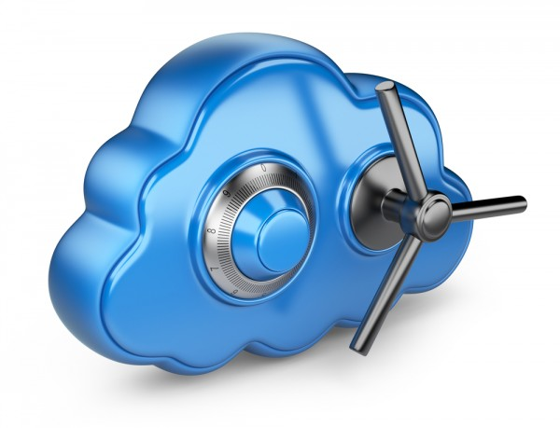
Module – 14 Securing the Storage Infrastructure
Module 14: Securing the Storage Infrastructure
1
Notes:
Module – 14
Securing the Storage Infrastructure

Slide 2
Module 14: Securing the Storage Infrastructure
Upon completion of this module, you should be able to:
Describe information security framework
Explain various storage security domains
Discuss security implementations in SAN, NAS, and IP SAN
Explain security in virtualized and cloud environments

Slide 3
Module 14: Securing the Storage Infrastructure
Lesson 1: Information Security Framework
During this lesson the following topics are covered:
Building information security framework
Risk triad
Security elements
Security controls

Slide 4
Storage Security
Process of applying information security principles and practices within the domain of storage networking technologies
Storage security focuses on securing access to information by implementing safeguards or controls
Storage security begins with building ‘information security framework’
Security
Storage
Networking
Information

Slide 5
Information Security Framework
A systematic way of defining security requirements
Framework should incorporate:
Anticipated security attacks
Actions that compromise the security of information
Security measures
Control designed to protect from these security attacks

Slide 6
Information Security Framework
Security framework is built to achieve four security goals:
Confidentiality
Ensures that only authorized users have access to data
Requires authentication of users who need to access information
Data in transit (data transmitted over cables) and data at rest (data residing on a primary storage, backup media, or in the archives) can be encrypted to maintain its confidentiality
Also requires to implement traffic flow protection measures as part of the security protocol
Generally include hiding source and destination addresses, frequency of data being sent, and amount of data sent

Slide 7
Information Security Framework
Security framework is built to achieve four security goals:
Integrity
Ensures that the information is unaltered
Requires detection and protection against unauthorized alteration or deletion of information
Error detection and correction for both data and systems
Availability
Ensures that authorized users have reliable and timely access to systems, data and applications residing on these systems
Requires protection against unauthorized deletion of data and denial of service
Sufficient resources are available to provide a service

Slide 8
Information Security Framework
Security framework is built to achieve four security goals:
Accountability
Accounting for all the events and operations that take place in the data center infrastructure
Accountability service maintains a log of events that can be audited or traced later for the purpose of security
Securing infrastructure begins with understanding the risk

Slide 9
Risk
To manage risks, organizations primarily focus on vulnerabilities
They cannot eliminate threat agents that appear in various forms and sources to its assets
Organizations can enforce countermeasures to reduce the possibility of occurrence of attacks and the severity of their impact

Slide 10
Risk Triad
Defines risk in terms of threats, assets, and vulnerabilities
Risk Triad
Risk
Threat Agent
Give rise to
Threats
Assets
Threat
That exploit
Vulnerabilities
Vulnerabilities
Wish to abuse and/or may damage
Leading to
Risk
Countermeasure
Impose
Owner
To reduce
To
Asset
Value

Slide 11
Risk Assessment
Risk assessment is the first step to determine the extent of potential threats and risks in an IT infrastructure
Assesses risk and helps to identify appropriate controls to mitigate or eliminate risks
Helps to prioritize the investment and provisioning of security measures
To determine the probability of an adverse event occurring, threats to an IT system must be analyzed with the potential vulnerabilities and the existing security controls

Slide 12
Assets
“Information” – the most important asset for any organization
Other assets include hardware, software, and network infrastructure
Protecting assets is the primary concern
Security considerations
Must provide easy access to assets for authorized users
Cost of securing the assets should be a fraction of the value of the assets
Make it difficult for potential attackers to access and compromise the assets
Should cost heavily to a potential attacker in terms of money, effort, and time

Slide 13
Threats
Potential attacks that can be carried out on an IT infrastructure
Attacks can be classified as passive or active
Passive attacks
Attempt to gain unauthorized access into the system
Attempt to threat the confidentiality of information
Active attacks
Attempt data modification, Denial of Service (DoS), and repudiation attacks
Attempt to threat data integrity, availability, and accountability

Slide 14
Threats
Denial of service (DoS)
Prevent legitimate users from accessing resources and services
Attacks generally do not involve access to or modification of information; instead, they pose a threat to data availability
Intentional flooding of a network or website to prevent legitimate access to authorized users is one example of a DoS attack
Repudiation
Attack against the accountability of information
Attempts to provide false information by either impersonating someone’s identity or denying that an event or a transaction has taken place
Include circumventing the logging of security events or tampering with the security log to conceal the identity of the attacker

Slide 15
Vulnerabilities
Paths that provide access to information are vulnerable to potential attacks
Requires implementation of “defense in depth”
Using multiple security measures to reduce the risk of security threats if one component of the protection is compromised
Also known as a “layered approach to security”
Factors to consider when assessing the extent to which an environment is vulnerable:
Attack surface
Various entry points that an attacker can use to launch an attack
Attack vector
step or a series of steps necessary to complete an attack

Slide 16
Vulnerabilities
Factors to consider when assessing the extent to which an environment is vulnerable:
Work factor
Amount of time and effort required to exploit an attack vector
For example, if attackers attempt to retrieve sensitive information, they consider the time and effort that would be required for executing an attack on a database
Managing vulnerabilities
Minimize the attack surface and maximize the work factor
Install controls (or countermeasures)

Slide 17
Security Controls
Reduces the impact of vulnerabilities
Any control measure should involve all the three aspects of infrastructure
People, process, and technology
Controls can be technical or non-technical
Technical: antivirus, firewalls, and intrusion detection system
Non-technical: administrative policies and physical controls

Slide 18
Security Controls
Controls are categorized as:
Preventive
Avert the vulnerabilities from being exploited and prevent an attack or reduce its impact
Corrective
Reduce the effect of an attack
Detective
Discover attacks and trigger preventive or corrective controls
Examples: Intrusion Detection/Intrusion Prevention System (IDS/IPS)

Slide 19
Module 14: Securing the Storage Infrastructure
Lesson 2: Storage Security Domains
During this lesson the following topics are covered:
Storage security domains
Security threats in each domain
Controls applied to reduce the risk in each domain

Slide 20


Storage Security Domains
Management Access
Backup, Replication, and Archive
Application Access
Storage
Network
Secondary
Storage
Data Storage

Slide 21
Storage Security Domains
Application access
Involves application access to the stored data through the storage network
Management access
Management access to storage and interconnect devices and to the data residing on those devices
Primarily accessed by storage administrators who configure and manage the environment
Backup, replication, and archive access
Along with the access points in this domain, the backup media also needs to be secured

Slide 22
Securing the Application Access Domain
Protect data and access to the data
Common Threats | Available Controls | Examples
Spoofing user or host identity Elevation of privileges Tampering with data in-flight and at rest Network snooping Denial of service Media theft | Strong user and host authentication and authorization Access control to storage objects Data encryption Storage network encryption | Multi-factor authentication RBAC, DH-CHAP Zoning, LUN masking Storage encryption IP-Sec, FC security protocol Antivirus Controlling physical access to data center

Slide 23
Securing the Management Access Domain
Involves protecting administrative access and management infrastructure
Common threats
Spoofing administrator’s identity
Elevating administrative privileges
Network snooping and DoS
Available controls
Authentication, authorization, and management access control
Private management network
Disable unnecessary network services
Encryption of management traffic

Slide 24
Securing Backup, Replication, and Archive Domain
Involves protecting backup, replication, and archive infrastructure
Common threats
Spoofing DR site identity
Tampering with data in-flight and at rest
Network snooping
Available controls
Access control – primary to secondary storage
Backup encryption
Replication network encryption

Slide 25
Module 14: Securing the Storage Infrastructure
Lesson 3: Security Implementations in Storage Networking
During this lesson the following topics are covered:
SAN security implementations
NAS security implementations
IP SAN security implementations

Slide 26
Security Implementation in SAN
Common SAN security mechanisms are:
LUN masking and zoning
Securing FC switch ports
Switch-wide and fabric-wide access control
Logical partitioning of a fabric: VSAN

Slide 27
Securing FC Switch Ports
Port binding
Restricts devices that can attach to a particular switch port
Allows only the corresponding switch port to connect to a node for fabric access
Port lockdown and port lockout
Restricts a switch port’s type of initialization
Persistent port disable
Prevents a switch port from being enabled even after a switch reboot

Slide 28
Switch-wide and Fabric-wide Access Control
Access control lists (ACLs)
Include device connection and switch connection control policies
Device connection control policy specifies which HBAs, storage ports can be connected to a particular switch
Switch connection control policy prevents unauthorized switches to join a particular switch
Fabric Binding
Prevents unauthorized switch from joining a fabric
Role-based access control (RBAC)
Enables assigning roles to users that explicitly specify access rights

Slide 29
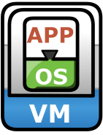
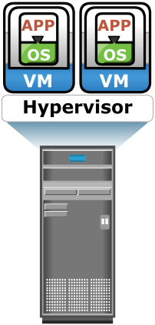
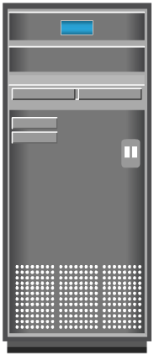
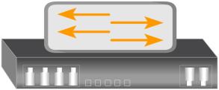
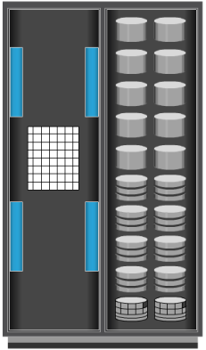
Logical Partitioning of a Fabric: VSAN
Enables the creation of multiple logical SANs over a common physical SAN
Fabric events in one VSAN are not propagated to the others
Zoning should be configured for each VSAN
VSAN 10
Engineering
VSAN 20
HR
Host
FC Switch
Hosts
Hosts
Storage
Array
Storage
Array
FC Switch

Slide 30

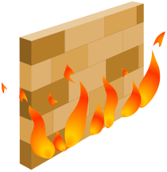

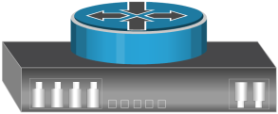
SAN Security Architecture: Defense-in-Depth
LAN
Security Zone A
Administrator
Security Zone B
Firewall
Security Zone D
Host - Switch
WAN
Security Zone E
Security Zone F
Distance Extension
Switch -
Switch/Router
Security Zone C
Access Control - Switch
Security Zone G
Switch - Storage

Slide 31
Zone A – Authentication at the Management Console
LAN
Security Zone A
Administrator
Security Zone B
Firewall
Security Zone D
Host - Switch
WAN
Security Zone E
Security Zone F
Distance Extension
Switch -
Switch/Router
Security Zone C
Access Control - Switch
Security Zone G
Switch - Storage

Slide 32
Zone A – Authentication at the Management Console
Restrict management LAN access to authorized users (lock down MAC addresses)
Implement VPN tunneling for secure remote access to the management LAN
Use two-factor authentication for network access

Slide 33
Zone B - Firewall
LAN
Security Zone A
Administrator
Security Zone B
Firewall
Security Zone D
Host - Switch
WAN
Security Zone E
Security Zone F
Distance Extension
Switch -
Switch/Router
Security Zone C
Access Control - Switch
Security Zone G
Switch - Storage

Slide 34
Zone B - Firewall
Filtering out addresses that should not be allowed on your LAN
Screening for allowable protocols
Block ports that are not in use

Slide 35
Zone C – Access Control-Switch
LAN
Security Zone A
Administrator
Security Zone B
Firewall
Security Zone D
Host - Switch
WAN
Security Zone E
Security Zone F
Distance Extension
Switch -
Switch/Router
Security Zone C
Access Control - Switch
Security Zone G
Switch - Storage

Slide 36
Zone C – Access Control-Switch
Authenticate users/administrators of FC switches using Remote Authentication Dial In User Service (RADIUS) and DH-CHAP (Diffie-Hellman Challenge Handshake Authentication Protocol)

Slide 37
Zone D – Host to Switch
LAN
Security Zone A
Administrator
Security Zone B
Firewall
Security Zone D
Host - Switch
WAN
Security Zone E
Security Zone F
Distance Extension
Switch -
Switch/Router
Security Zone C
Access Control - Switch
Security Zone G
Switch - Storage

Slide 38
Zone D – Host to Switch
ACLs: Known HBAs can connect on specific switch ports only
Secure zoning method, such as port zoning (also known as hard zoning)

Slide 39
Zone E – Switch to Switch/Switch to Router
LAN
Security Zone A
Administrator
Security Zone B
Firewall
Security Zone D
Host - Switch
WAN
Security Zone E
Security Zone F
Distance Extension
Switch -
Switch/Router
Security Zone C
Access Control - Switch
Security Zone G
Switch - Storage

Slide 40
Zone E – Switch to Switch/Switch to Router
Using E_Port authentication
Encrypting the traffic in transit
Implementing FC switch controls and port controls

Slide 41
Zone F – Distance Extension
LAN
Security Zone A
Administrator
Security Zone B
Firewall
Security Zone D
Host - Switch
WAN
Security Zone E
Security Zone F
Distance Extension
Switch -
Switch/Router
Security Zone C
Access Control - Switch
Security Zone G
Switch - Storage

Slide 42
Zone F – Distance Extension
FC-SP for long-distance FC extension
IPSec for SAN extension via FCIP

Slide 43
Zone G – Switch to Storage
LAN
Security Zone A
Administrator
Security Zone B
Firewall
Security Zone D
Host - Switch
WAN
Security Zone E
Security Zone F
Distance Extension
Switch -
Switch/Router
Security Zone C
Access Control - Switch
Security Zone G
Switch - Storage

Slide 44
Zone G – Switch to Storage
WWPN-based LUN masking
S_ID locking: masking based on source Fibre Channel address

Slide 45
Security Implementation in NAS
Permissions and ACLs
Protection to NAS resources by restricting access
Other authentication and authorization mechanisms
Kerberos and Directory services
Implemented to verify the identity of network users and define their privileges
Firewalls
To protect the storage infrastructure from unauthorized access and malicious attacks

Slide 46
NAS File Sharing: Windows ACLs
Types of ACLs
Discretionary access control lists (DACL)
Commonly referred to as ACL and used to determine access control
System access control lists (SACL)
Determine what access needs to be audited if auditing is enabled
Object Ownership
Object owner has hard-coded rights to that object
Child objects within a parent object automatically inherit the ACLs of parent object
Security identifiers (SIDs)
SIDs uniquely identify a user or a user group
ACLs use SIDs to control access to the objects

Slide 47
NAS File Sharing: UNIX Permissions
UNIX permissions specify what can be done to a file and by whom
Common permissions: Read/Write/Execute
Every file and directory (folder) has three ownership relations:
Rights for the file owner
Rights for the group the user belong to
Rights for all other users

Slide 48
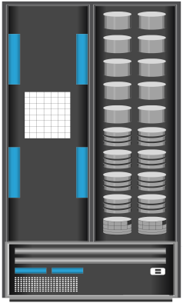
Authentication and Authorization
NIS Server
Authorization
UNIX object
-rwxrwxrwx
UNIX Client
Windows object
ACL
SID abc deny write
SID xyz allow write
UNIX Authentication
User root
NAS Device
Windows Client
Windows Authentication
Validate permissions
with NIS or
Domain Controller
User SID - abc
Windows Domain Controller/
Active Directory

Slide 49
Kerberos – Network Authentication Protocol
Uses secret-key cryptography
A client can prove its identity to a server (and vice versa) across an insecure network connection
Kerberos client
An entity that gets a service ticket for a Kerberos service
Kerberos server
Refers to the Key Distribution Center (KDC)
Implements the Authentication Service (AS) and the Ticket Granting Service (TGS)

Slide 50
Kerberos Authorization
KDC
Windows
Client
ID Proof (1)
TGT (2)
TGT + Server name (3)
KerbC (KerbS TKT) (5)
(4)
NAS
(7)
Device
Keytab
Active
Directory

Slide 51
Kerberos Authorization
The user logs on to the workstation in the Active Directory domain (or forest) using an ID and a password. The client computer sends a request to the AS running on the KDC for a Kerberos ticket. The KDC verifies the user’s login information from Active Directory.
The KDC responds with an encrypted Ticket Granting Ticket (TGT) and an encrypted session key. TGT has a limited validity period. TGT can be decrypted only by the KDC, and the client can decrypt only the session key.
When the client requests a service from a server, it sends a request, consisting of the previously generated TGT, encrypted with the session key and the resource information to the KDC.

Slide 52
Kerberos Authorization
The KDC checks the permissions in Active Directory and ensures that the user is authorized to use that service.
The KDC returns a service ticket to the client. This service ticket contains fields addressed to the client and to the server hosting the service.
The client then sends the service ticket to the server that houses the required resources.
The server, in this case the NAS device, decrypts the server portion of the ticket and stores the information in a keytab file. As long as the client’s Kerberos ticket is valid, this authorization process does not need to be repeated. The server automatically allows the client to access the appropriate resources.

Slide 53
Kerberos Authorization
A client-server session is now established. The server returns a session ID to the client, which tracks the client activity, such as file locking, as long as the session is active.

Slide 54
Network Layer Firewalls
Firewalls are implemented in NAS environments
To protect against security threats in IP network
To examine network packets and compare them to a set of configured security rules
Packets that are not authorized by a security rule are dropped
Demilitarized Zone (DMZ)
To secure internal assets while allowing Internet-based access to various resources
External
Network
Internal
Network
Application Server
Demilitarized Zone (DMZ)

Slide 55
Security Implementation in IP SAN: CHAP
Challenge-Handshake Authentication Protocol (CHAP)
Provides a method for initiators and targets to authenticate each other by utilizing a secret code
1. Initiates a login to the target
Initiator
2. CHAP challenge sent to initiator
Target
3. Takes shared secret and calculates value using a one-way hash function
4. Returns hash value to the target
Host
5. Computes the expected hash value from the shared secret and compares the value received from initiator
iSCSI
Storage Array
6. If value matches, authentication is acknowledged

Slide 56
Securing IPSAN with iSNS Discovery Domains
iSNS can be a part
Management
of network or
Device B
Platform
management station
IP SAN
Two
Discovery
Domains
Host A
Device A
Host B
Host C

Slide 57
Module 14: Securing the Storage Infrastructure
Lesson 4: Security in Virtualized and Cloud Environments
During this lesson the following topics are covered:
Security concerns
Security measures

Slide 58
Security in Virtualized and Cloud Environments
These environments have additional threats due to multitenancy and lack of control over the cloud resources
Virtualization-specific security concerns are common for all cloud models
In public clouds, there are additional security concerns, which demand specific countermeasures
Clients have less control to enforce security measures in public clouds
Difficult for cloud service provider(CSP) to meet the security needs of all the clients

Slide 59
Security Concerns
Multitenancy
Enables multiple independent tenants to be serviced using the same set of storage resources
Co-location of multiple VMs in a single server and sharing the same resources increase the attack surface
Velocity of attack
Any existing security threat in the cloud spreads more rapidly and has larger impact than that in the traditional data center
Information assurance and data privacy

Slide 60
Security Measures
Securing compute
Securing physical server, VMs, and hypervisor
Securing network
Virtual firewall
Provides packet filtering and monitoring of the VM-to-VM traffic
DMZ and data encryption
Securing storage
Access control and data encryption
Use separate LUNs for VM configuration files and VM data
Segregate VM traffic from management traffic

Slide 61
Module 14: Securing the Storage Infrastructure
Concept in Practice
RSA security products
VMware vShield

Slide 62
RSA Security Products
RSA SecureID
Provides two-factor authentication
Based on something a user knows (a password or PIN) and something a user has (an authenticator device)
Authenticator device automatically changes passwords every 60 seconds
RSA Identity and Access Management
Provides identity, security, and access-control management for physical, virtual, and cloud-based environments
RSA Data Protection Manager
Enables deployment of encryption, tokenization, and enterprise key management

Slide 63
VMware vShield
VMware vShield family includes three products
vShield App
Hypervisor-based application-aware firewall solution
Observes network activity between virtual machines
vShield Edge
Provides comprehensive perimeter network security
Deployed as a virtual appliance and serves as a network security gateway for all the hosts
Provides many services including firewall, VPN, and DHCP
vShield Endpoint
Consists of a hardened special security VM with a third party antivirus software

Slide 64
Module 14: Summary
Key points covered in this module:
Information security framework
Storage security domains
Controls that can be deployed against identified threats in each domain
SAN security architecture
Protection mechanisms in SAN, NAS, and IP SAN environments
Security in virtualized and cloud environments

